Slide 1


Kohsuke Kawaguchi
InfraDNA, Inc.

Slide 2

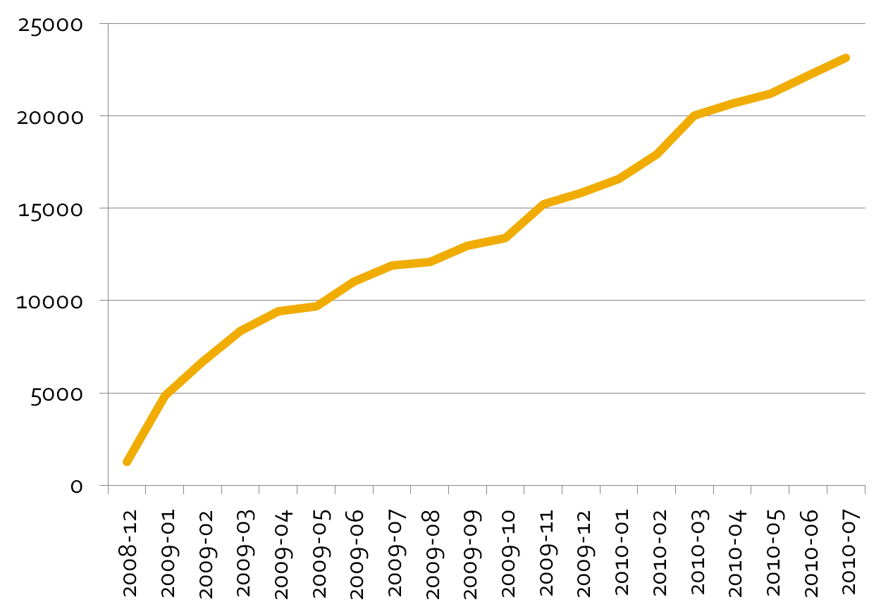

Slide 3

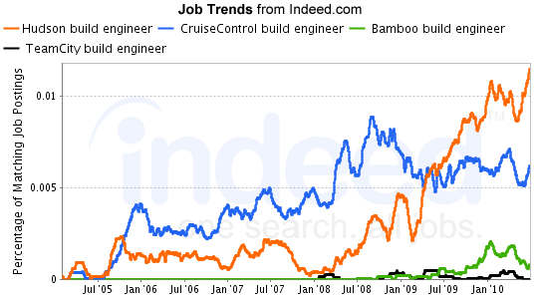

Slide 4

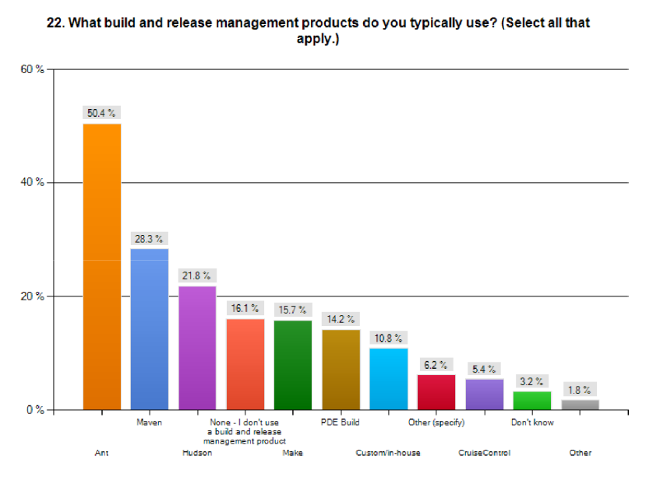

Slide 5

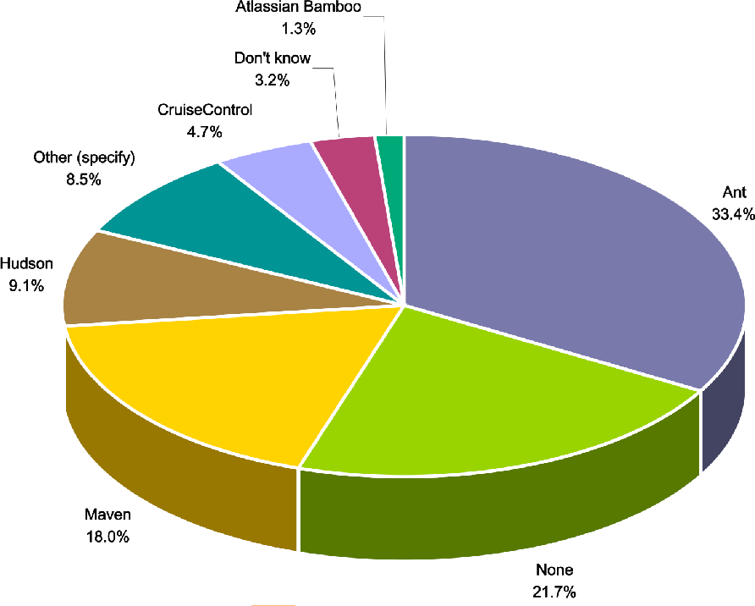

Slide 6

What CI Server are you using?
 | 2008 | 2009 | 2010
Hudson | 39% | 46% | 67%
CruiseControl | 18% | 12% | 3%
Bamboo | 7% | 5% | 8%
TeamCity | 9% | 14% | 7%

Slide 7

I left Oracle in April
Does that negatively impact Hudson?
  I don’t think so, and not so far
  Hudson has always been community-driven
New Arrangements
  I continue to lead, and Oracle is good with this
    Oracle appointed another person for integration with their products
  Oracle acts as CLA consolidation point
  No fork in sight

Slide 8

Consulting
  Custom plugin development
  Feature implementation into core
  Troubleshoot deployment issues
  Deployment assistance
Support Subscriptions
  Bug fixes, priority Q&As
  Open-source Hudson and plugins
ICHCI (InfraDNA’s Certified Hudson CI)
  Commercial value-add distribution

Slide 9


Slide 10

More foundation work
More parallelism
More complex workflow

Slide 11

Add more interesting extension points
  Console annotation
  Custom matrix axis
Infrastructure improvements
  Around Queue
  Around UI
  Around remoting

Slide 12

Plugins should expose its own extension points
  Example: instant-messenger plugin
  Example: test result parser plugin
  Facilitates code reuse, simplifies plugin development

Slide 13

Job definition DSL
  Use programming languages to define more complex distributed workflow
  Function call, parameters, loop, parallel-execution…
  Distributed execution support
  Also useful for templating

Slide 14

Distributed unit testing
  Hook in at Surefire/<junit> task level and run unit tests in parallel
Elastic build environment
  Provision on demand, throw away at the end
  Eucalyptus? vSphere? vCloud? VirtualBox?

Slide 15

Hook scripts as light-weight plugins
  Make customization easier for non-Java folks
Pre-tested commits
  Send patch to Hudson and run it there
  Client side is the main problem
Hierarchical job grouping
  Should also help with access control
Inter-Hudson cooperation

Slide 16

Obviously, InfraDNA
Hosted CI based on Hudson
  MikeCI, CloudBees
Adapters / integration with other tools
  Oracle, CollabNet, Sonatype, JFrog, Mylyn
This should results in more investments to the project

Slide 17

Hudson is doing greater than ever
Came a long way but still got a long way to go
Tell us what you think
  Where are the pains?
  What else should we be doing?

Slide 18


